Slide 1

Disaggregating the Steel Sector in MRIO: Global Supply Chain Variations in BF-BOF and EAF Steelmaking
Seiya Imadaª*, Shigemi Kagawa^{b}
a: Graduate School of Economics, Kyushu University, Fukuoka, Japan
b: Faculty of Economics, Kyushu University, Fukuoka, Japan
Notes:
Good afternoon.
I’m Seiya Imada from Kyushu University.
Today, I am here to talk about 〜

Slide 2



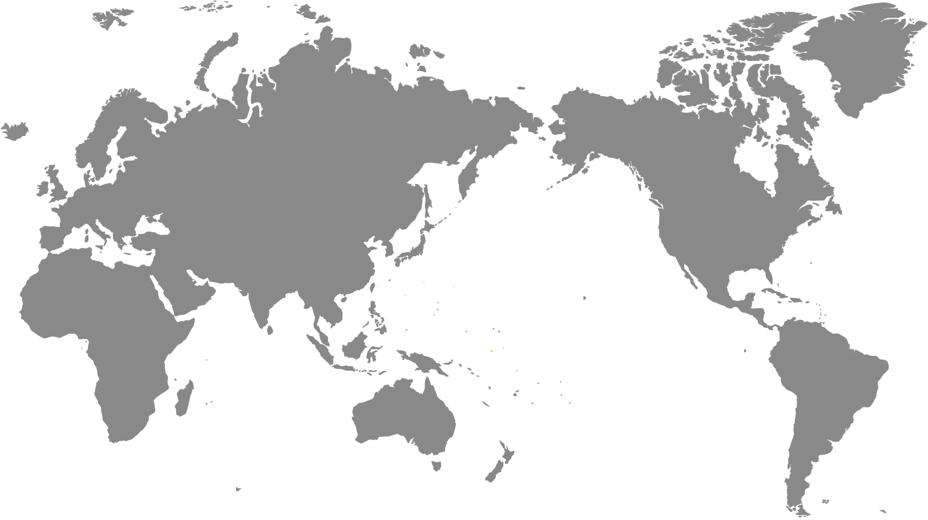






1
Building and infrastructure
Steel Use
1.8 billion tons
52%
12%
10%
Steel products were traded internationally in 2023
280 million tons
Automotive
Metal products
Notes:
So, let me begin my presentation with the introduction.
World Steel Association reported that global steel use reached about 1.8 billion tons in 2023.
Of the total steel use, 52% were used in building and infrastructure, 12% were used in Automotive sector.
These numbers highlight the important role of the steel sector in both our society and the economies.
Also, around 280 million tons of the steel products were traded internationally in 2023, which was about 15% of the total steel use that year.

Slide 3






2
Indirect emissions through domestic and international final demands (Chen et al, 2017; Peng et al, 2018)
Direct CO₂ emissions
2.6 billion tons
The iron and steel sector must reduce its direct emissions by 25% by 2030 in order to achieve net-zero emissions by 2050 (IEA, 2023).
It is important to introduce hydrogen technology and electric furnace using renewable energy (Karakaya et al., 2018; Ren et al., 2021).
Notes:
The iron and steel sector plays a major role in the economy and also significantly affects the environment.
The direct CO2 emissions from this sector reached 2.6 billion tons in 2020, accounting for 7% of global CO2 emissions.
In addition to direct CO2 emissions, the iron and steel sector also causes indirect emissions through domestic and international final demands, such as construction and automotive sectors.
According to IEA report, the iron and steel sector must reduce its direct emissions by 25% by 2030 in order to achieve net-zero emissions by 2050.
Therefore, it is important to introduce hydrogen technology and electric furnace using renewable energy.

Slide 4
3
Indirect emissions through domestic and international final demands (Chen et al, 2017; Peng et al, 2018)
Direct CO₂ emissions
2.6 billion tons
To reduce indirect emissions, effective policies targeting CO₂ reductions throughout global supply chains are crucial.
To establish an effective policy, it need to identify CO₂ emission hotpots in the iron and steel sector.
Notes:
Meanwhile, to reduce indirect emissions, effective policies targeting CO₂ reductions throughout global supply chains are crucial.
To establish an effective policy, it need to identify CO₂ emission hotpots in the iron and steel sector.

Slide 5
4
Previous studies on CO₂ emissions and energy use from global supply chain (GSC) employ multi-regional input–output (MRIO) analysis.
Chen et al. (2017)
Peng et al. (2018)
CO₂ emissions from China’s construction sector between 1995 and 2011 using the World Input–Output Database (WIOD).
The basic metals and fabricated metal products sectors were found to account for approximately 11% of construction-related CO₂ emissions in China from 1995 to 2009.
Notes:
Many previous studies on CO2 emissions and energy use from global supply chain (GSC) have employed multi-regional input–output (MRIO) analysis.
For example, Chen et al, 2017 estimated CO₂ emissions from China’s construction sector between 1995 and 2011 using the World Input–Output Database (WIOD).
They clarified that the basic metals and fabricated metal products sectors were found to account for approximately 11% of construction-related CO₂ emissions in China from 1995 to 2009.

Slide 6
5
Previous studies on CO₂ emissions and energy use from global supply chain (GSC) employ multi-regional input–output (MRIO) analysis.
Chen et al. (2017)
Peng et al. (2018)
They identified key supply chain paths that contribute to CO₂ emission from China’s iron and steel sector by using WIOD.
They showed that indirect demand from sectors like construction also causes significant CO₂ emissions, in addition to direct domestic demand.
In existing MRIO, the entire process from crude steel production to steel products is typically aggregated into a single sector.
Notes:
Peng et al, 2018 identified key supply chain paths that contribute to CO₂ emission from China’s iron and steel sector by using WIOD.
As a result, they showed that indirect demand from sectors like construction also causes significant CO₂ emissions, in addition to direct domestic demand.
However, in existing MRIO frameworks, the entire process from crude steel production to steel products is typically aggregated into a single sector.

Slide 7








6
Existing MRIO
？
Existing MRIOs cannot capture the characteristics of different steelmaking routes.
Blast furnace–basic oxygen furnace
(BF-BOF)
Electric arc furnace
(EAF)
Steel products
Notes:
In other words, existing MRIOs cannot capture the characteristics of different steelmaking routes such as the blast furnace–basic oxygen furnace (BF-BOF), the electric arc furnace (EAF), and finished steel products.

Slide 8
7
Existing MRIO
？
BF-BOF
Raw material: coking coal and iron ore
Typical applications: automotive body frames and structural components in buildings and infrastructure
EAF
Steel products
Notes:
For example, the BF-BOF route mainly uses coking coal and iron ore as raw materials.
Its products are typically used for automotive body frames and structural components in buildings and infrastructure.

Slide 9

8
Existing MRIO
？
BF-BOF
Raw material: steel scrap, natural gas-based DRI and coal-based DRI
Typical applications: construction-use rebar and steel plates
EAF
Steel products
Notes:
In contrast, the EAF route relies on raw materials such as steel scrap, natural gas-based DRI, and coal-based DRI.
The composition of inputs can vary (ヴェアリィ) significantly by country, even within the same EAF method.
EAF steel is often used for construction-use rebar (リーバー) and steel plates.

Slide 10

9
Average BF-BOF CO₂ intensity
2.33 t-CO₂
Average DRI-EAF CO₂ intensity
1.37 t-CO₂
Average scrap-EAF CO₂ intensity
0.68 t-CO₂
Notes:
These differences affect both the environmental impact at the production stage and the structure of the supply chain.
According to the World Steel Association, the average CO₂ emission intensity of BF-BOF is 2.33 t-CO₂ per ton of crude steel cast.
For DRI-EAF, it is 1.37, and for scrap-based EAF, it is as low as 0.68.

Slide 11

8
This shows that CO₂ emission intensity vary significantly depending on the production method and raw materials used.
Average BF-BOF CO₂ intensity
2.33 t-CO₂
Average DRI-EAF CO₂ intensity
1.37 t-CO₂
Average scrap-EAF CO₂ intensity
0.68 t-CO₂
Notes:
This shows that CO2 emission intensity vary significantly depending on the production method and raw materials used.

Slide 12
9
Existing MRIO models overlook these differences and may produce inaccurate estimates, such as overestimating or underestimating emissions from the iron and steel sector.
Novelty of this study
This study disaggregates the basic iron sector in GLORIA for six major countries into four subsectors: pig iron, converter, EAF, and steel products.
Notes:
Therefore, existing MRIO models overlook these differences and may produce inaccurate estimates, such as overestimating or underestimating emissions from the iron and steel sector.
The novelty of this study lies in its disaggregation of the basic iron sector in the GLORIA MRIO database for six major countries—China, India, Japan, South Korea, Russia, and the United States—into four subsectors: pig iron, converter, EAF, and finished steel products.

Slide 13
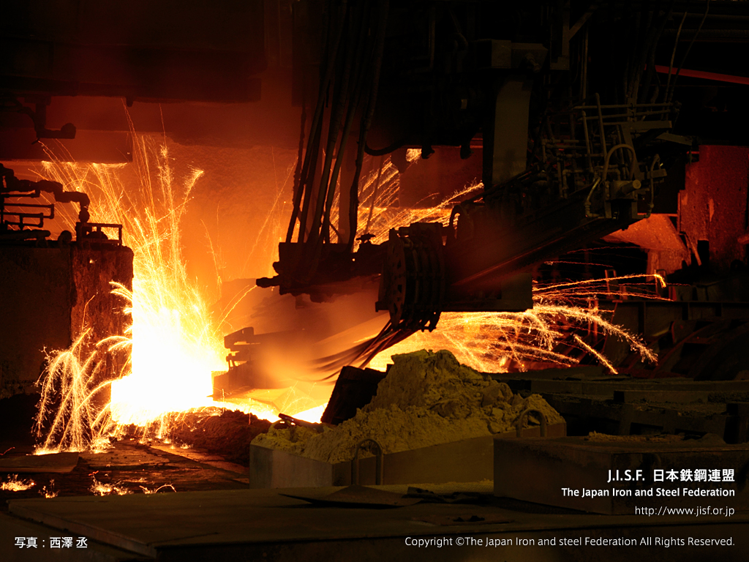

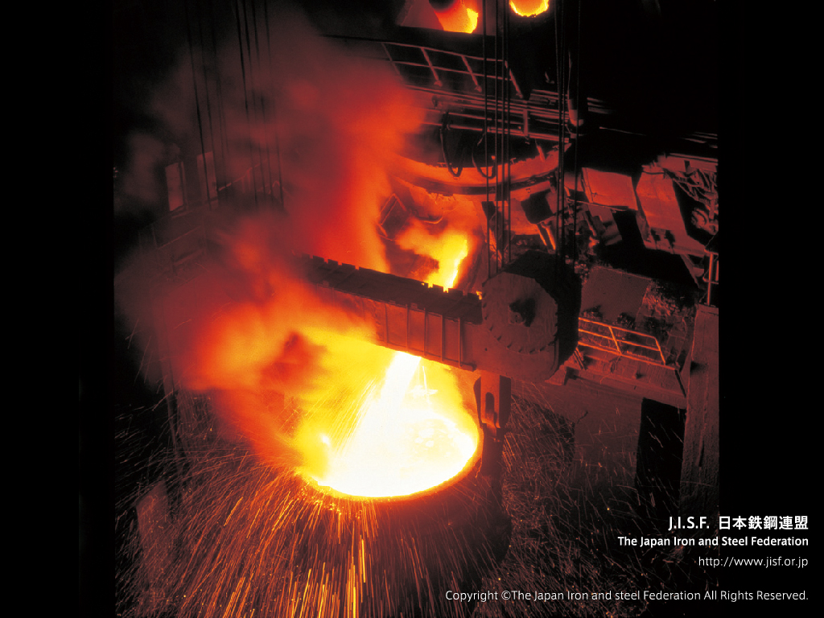
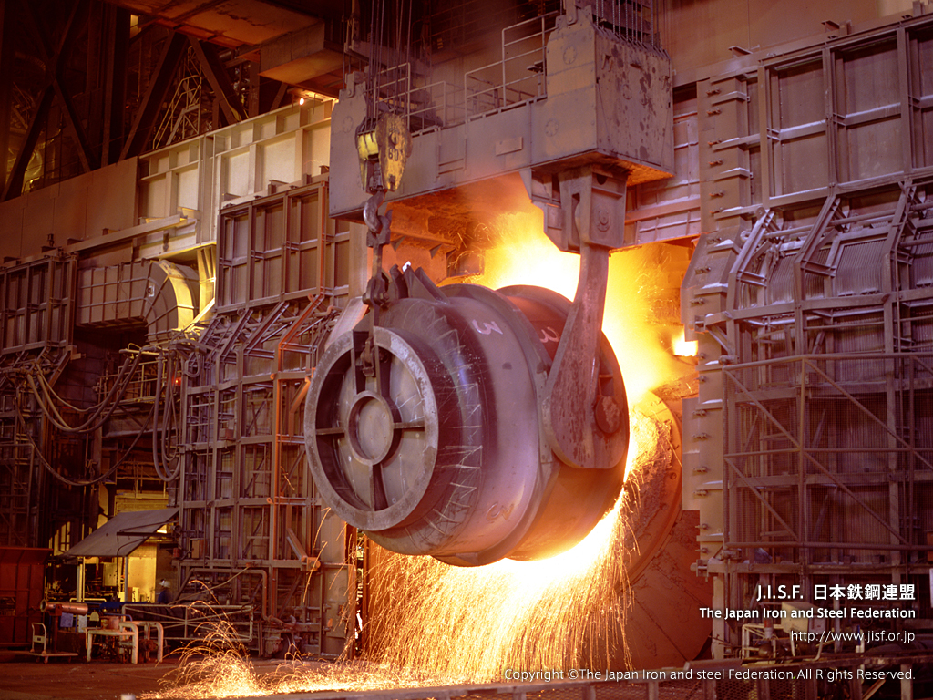
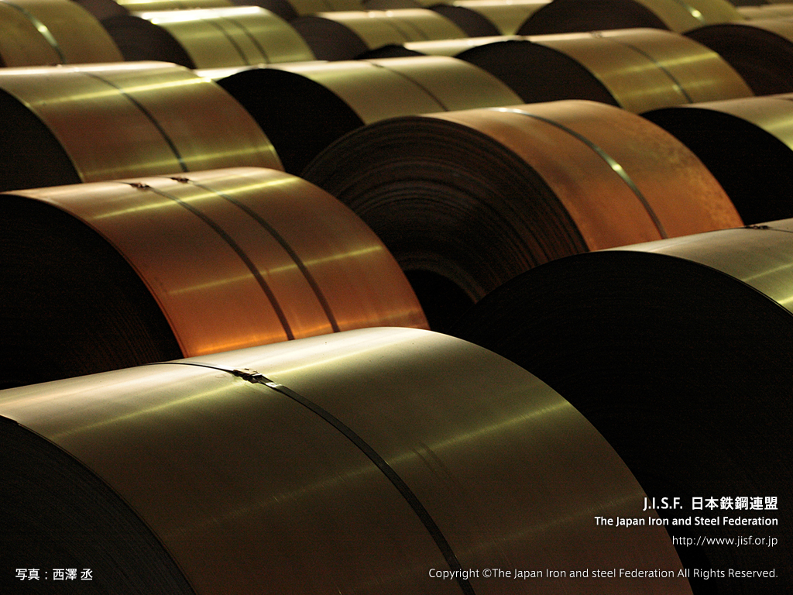
2.Methodology: Tree diagram of basic iron sector disaggregation
10
Basic iron
Crude steel
BF-BOF
Pig iron
From crude steel (BF-BOF, EAF) to steel products.
Converter
EAF
Steel products
Notes:
This study disaggregates the Basic Iron sector, which includes everything from crude steel to finished steel products, into four categories: pig iron, converter, EAF, and steel products.
And this is tree diagram of basic iron sector disaggregation.

Slide 14









2.Methodology: Disaggregation of the basic iron (row)
11
Basic iron
Basic iron
Basic iron
Basic iron
$$⋮$$
$$⋮$$
$$⋮$$
$$⋮$$
Iron ore
50
24
60
Pig iron
Basic iron
100
Crude steel
67
BF-BOF
36
Converter
7
80
33
EAF
Coke
Steel products
7
33
$$⋮$$
33
$$⋮$$
$$⋮$$
$$⋮$$
Notes:
Here is the tree diagram, using the intermediate input vector of China’s Basic Iron sector as an example.
I'll briefly explain each part of the disaggregation.

Slide 15




2.Methodology: Disaggregation of the basic iron (row)
12
Basic iron
Basic iron
Basic iron
Basic iron
$$⋮$$
$$⋮$$
$$⋮$$
$$⋮$$
50
In Japan’s IO table, the steel sector is disaggregated into pig iron, converter, EAF, and steel products.
Iron ore
24
Basic iron (row)
60
Pig iron
100
Crude steel
67
BF-BOF
36
Converter
7
We used Japan’s IO table as detailed technical data for the steel sector to support this disaggregation.
80
33
EAF
Coke
Steel products
7
33
$$⋮$$
33
$$⋮$$
$$⋮$$
$$⋮$$
Notes:
First, I explain the disaggregation of Basic Iron into crude steel and steel products.
In Japan’s IO table, the steel sector is disaggregated into pig iron, converter, EAF, and steel products.
Therefore, we used Japan’s IO table as detailed technical data for the steel sector to support this disaggregation.

Slide 16



2.Methodology: Disaggregation of the basic iron (row)
13
Basic iron
Basic iron
Basic iron
Basic iron
$$⋮$$
$$⋮$$
$$⋮$$
Iron ore
50
24
60
Pig iron
Basic iron
100
Crude steel
67
BF-BOF
36
Converter
7
80
33
EAF
Coke
Steel products
7
7
33
$$⋮$$
We multiply each country’s BF-BOF and EAF production ratios by the value of crude steel intermediate input.
$$⋮$$
$$⋮$$
$$⋮$$
Notes:
Next, I explain the disaggregation of crude steel into BF-BOF and EAF.
We multiply each country’s BF-BOF and EAF production ratios by the value of crude steel intermediate input.

Slide 17



2.Methodology: Disaggregation of the basic iron (row)
14
Basic iron
Basic iron
Basic iron
Basic iron
$$⋮$$
$$⋮$$
$$⋮$$
$$⋮$$
We could not find detailed, country-specific input data for pig iron and converter sectors.
Iron ore
50
24
60
Pig iron
Basic iron
100
Crude steel
67
BF-BOF
We used Japan’s IO table, where the steel sector is already divided into pig iron and converter.
36
Converter
7
80
33
EAF
Coke
Steel products
7
33
$$⋮$$
33
$$⋮$$
$$⋮$$
$$⋮$$
Notes:
Next, I explain the disaggregation of BF-BOF into pig iron and converter.
We could not find detailed, country-specific input data for pig iron and converter sectors.
So, similar to how we disaggregated crude steel and finished steel products, we used Japan’s input–output table, where the steel sector is already divided into pig iron and converter.

Slide 18












2.Methodology: Disaggregation of the basic iron (column)
15
Basic iron
(column)
Crude steel
Steel products
BF-BOF
EAF
Pig iron
Converter
$$⋮$$
$$⋮$$
$$⋮$$
$$⋮$$
$$⋮$$
$$⋮$$
$$⋮$$
Iron ore
50
50
0
50
0
50
0
24
20
4
18
2
2
16
Pig iron
Converter
36
0
36
0
0
0
0
7
1
6
0
1
0
0
EAF
Steel products
33
0
33
0
0
0
0
Coke
80
45
35
45
0
45
0
$$⋮$$
$$⋮$$
$$⋮$$
$$⋮$$
$$⋮$$
$$⋮$$
$$⋮$$
Notes:
From here, I will explain the breakdown of the intermediate input structure of the Basic Iron sector.
The overall structure of the disaggregation is shown here.

Slide 19







2.Methodology: Disaggregation of the basic iron (column)
16
Basic iron
(column)
Crude steel
Steel products
BF-BOF
EAF
Pig iron
Converter
$$⋮$$
$$⋮$$
$$⋮$$
$$⋮$$
$$⋮$$
$$⋮$$
$$⋮$$
Iron ore
50
50
0
50
0
50
0
24
20
4
18
2
2
16
Pig iron
Here as well, we use Japan’s input–output table as detailed technical data for the steel sector.
Converter
36
0
36
0
0
0
0
7
1
6
0
1
0
0
EAF
Steel products
33
0
33
0
0
0
0
Coke
80
45
35
45
0
45
0
$$⋮$$
$$⋮$$
$$⋮$$
$$⋮$$
$$⋮$$
$$⋮$$
$$⋮$$
Notes:
Just like in the row direction, we disaggregate Basic Iron into crude steel and steel products.
Here as well, we use Japan’s input–output table as detailed technical data for the steel sector.

Slide 20









2.Methodology: Disaggregation of the basic iron (column)
17
Crude steel
BF-BOF
EAF
Pig iron
Converter
$$⋮$$
$$⋮$$
$$⋮$$
$$⋮$$
$$⋮$$
Iron ore
50
50
0
50
0
20
18
2
2
16
Pig iron
We disaggregate the intermediate inputs of crude steel into BF-BOF and EAF, using country-level cost data for each process provided by TransitionZero.
Converter
0
0
0
0
0
1
0
1
0
0
EAF
Steel products
0
0
0
0
0
Coke
45
45
0
45
0
$$⋮$$
$$⋮$$
$$⋮$$
$$⋮$$
$$⋮$$
Notes:
Next, I explain the disaggregation of crude steel into BF-BOF and EAF.
In this part, we disaggregate the intermediate inputs of crude steel into BF-BOF and EAF, using country-level cost data for each process provided by TransitionZero.

Slide 21




2.Methodology: Disaggregation of the basic iron (column)
18
BF-BOF
EAF
Pig iron
Converter
$$⋮$$
$$⋮$$
$$⋮$$
$$⋮$$
Iron ore
50
0
50
0
18
2
2
16
Pig iron
Here as well, we use Japan’s input–output table as detailed technical data for the steel sector.
Converter
0
0
0
0
0
1
0
0
EAF
Steel products
0
0
0
0
Coke
45
0
45
0
$$⋮$$
$$⋮$$
$$⋮$$
$$⋮$$
Notes:
Finally, we disaggregate BF-BOF into pig iron and converter.
Here as well, we use Japan’s input–output table as detailed technical data for the steel sector.

Slide 22
3. Data
19
GLORIA MRIO database in 2021 (Lenzen et al., 2017; Lenzen et al., 2021)
Input–Output Table of Japan in 2015 (Ministry of Internal Affairs and Communications, 2019)
Global Steel Production Costs (GSCT) (TransitionZero, 2022)
World Steel in Figures 2024 (World Steel Association, 2024)
2006 IPCC Guidelines for National Greenhouse Gas Inventories (IPCC, 2006)
Country-specific emission factors related to electricity generation(Ember, 2025)
Notes:
This study use these data to disaggregate the basic iron sector.

Slide 23
4. Results: Intermediate input in China’s pig iron sector
20
Top 3 intermediate goods required for pig iron production in China
Iron ore (#28)
4 %
China’s
pig iron
Coke oven products (#62)
57 %
Hard coal (#24)
18 %
Others
The iron ore sector (#28) has the highest share at 57 %.
This is followed by coke oven products sector (#62) with a share of 18 %.
The hard coal sector (#24) accounts for 4 %.
Notes:
In this presentation, due to time limitations, I focus on China’s pig iron and converter sectors.
This graph shows the Top 3 intermediate goods required for pig iron production in China.
Light blue is iron ore, Orange is coke oven products and red is hard coal sectors.
This graph reveals the following three points.
The iron ore sector (#28) has the highest share at 57 %.
This is followed by coke oven products sector (#62) with a share of 18 %.
The hard coal sector (#24) accounts for 4 %.

Slide 24
4. Results: Intermediate input in China’s converter sector
21
Top 3 intermediate goods required for converter production in China
Pig iron (#77-1)
China’s
converter
Finance and insurance (#112)
49 %
Hard coal (#24)
Others
6 %
6 %
The pig iron sector (#77-1) accounting for the largest share at 49%.
Since the converter process aims to remove impurities from pig iron, pig iron (#77-1) makes up most intermediate inputs in the converter sector.
Notes:
This graph shows the top 3 intermediate goods required for converter production in China.
Blue is Pig iron, green is Finance and insurance sectors.
This graph shows the pig iron sector accounting for the largest share at 49 ％.
Since the converter process aims to remove impurities (イムピュアリティーズ) from pig iron, pig iron makes up most intermediate inputs in the converter sector.

Slide 25
4. Results: Intermediate input in China’s basic iron sector
22
Top 3 intermediate goods required for basic iron production in China
27 %
Basic iron (#77)
China’s
basic iron
Iron ore (#28)
Coke oven products (#62)
24 %
Others
10 %
The basic iron sector (#77) accounts for the largest share at 27 %.
This is followed by the iron ore sector (#28) with 24 %.
The coke oven products sector (#62) accounts for 10 %.
Notes:
This graph shows the 3 intermediate goods required for basic iron production in China.
Purple is basic iron sector.
This graph shows that the basic iron sector (#77) accounts for the largest share at 27 %.
This is followed by the iron ore sector (#28) with 12 %.
The coke oven products sector (#62) accounts for 10 %.

Slide 26
4. Results: Comparison before and after disaggregation
23
Before disaggregation
After disaggregation
27 %
4 %
Basic iron
Pig iron
57 %
Converter
49 %
18 %
24 %
10 %
6 %
6 %
Comparing the basic iron sector with the disaggregated pig iron and converter sectors shows that it was unclear which steelmaking process the basic iron sector actually represented or was mainly influenced by.
Notes:
These results can be summarized as follows.
Comparing the basic iron sector with the disaggregated pig iron and converter sectors shows that it was unclear which steelmaking process the basic iron sector actually represented or was mainly influenced by.

Slide 27
4. Results: Embodied CO₂ emission intensity of steel sector
24
The embodied emission intensity of the pig iron sector is higher than that of the basic iron sector.
A scatter plot of embodied CO₂ emission intensities for the basic iron, pig iron, converter, EAF, and steel products sectors by country
Notes:
This figure shows a scatter plot of embodied CO₂ emission intensities for the basic iron, pig iron, converter, EAF, and steel products sectors by country.
Gray is basic iron, red is pig iron, blue is converter, yellow is eaf ,green is steel products sectors.
This figure shows that, in all countries except South Korea, the embodied emission intensity of the pig iron sector is higher than that of the basic iron sector.

Slide 28
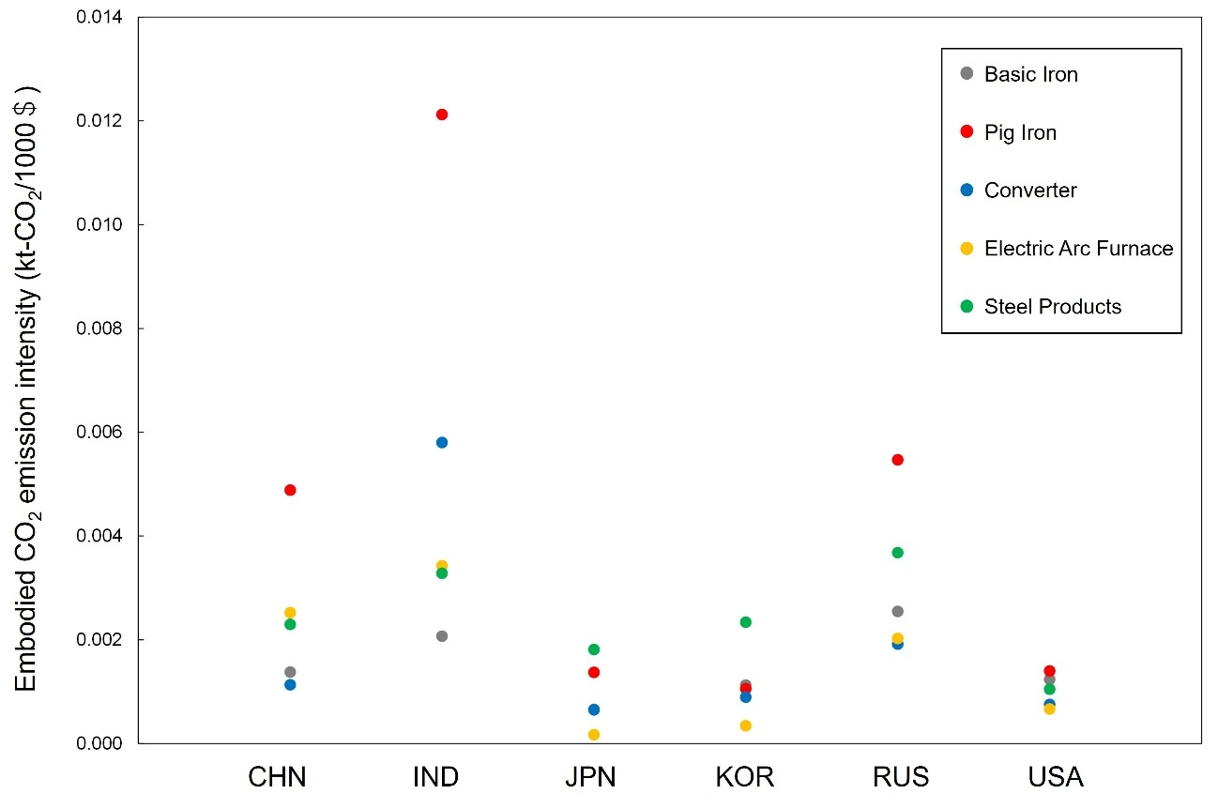
4. Results: Embodied CO₂ emission intensity of steel sector
25
In China and India, the pig iron sectors show embodied CO₂ emission intensities that are about four times and six times higher, respectively, than those of their basic iron sectors.
In contrast, the embodied CO₂ emission intensity of Japan’s EAF sector is just one-fourth that of its basic iron sector.
A scatter plot of embodied CO₂ emission intensities for the basic iron, pig iron, converter, EAF, and steel products sectors by country
Notes:
Notably, in China and India, the pig iron sectors show embodied CO₂ emission intensities that are about four times and six times higher, respectively, than those of their basic iron sectors.
In contrast, the embodied CO₂ emission intensity of Japan’s EAF sector is just one-fourth that of its basic iron sector.
Please note that in this Figure, the embodied emission intensities of Japan’s Basic Iron and Converter sectors are nearly identical, so they appear to overlap.

Slide 29
4. Results
26
These results suggest that aggregating the pig iron, converter, EAF, and steel products sectors into a single basic iron sector may introduce aggregation bias in analyses of sectoral direct and indirect CO₂ emission intensities within MRIO frameworks.
When conducting carbon footprint analyses based on the basic iron sector, careful attention should be paid to the potential influence of such bias.
Notes:
These results suggest that aggregating the pig iron, converter, EAF, and steel products sectors into a single basic iron sector may introduce aggregation bias in analyses of sectoral direct and indirect CO₂ emission intensities within MRIO frameworks.
Therefore, when conducting carbon footprint analyses based on the basic iron sector, careful attention should be paid to the potential influence of such bias.

Slide 30
5. Discussion
27
In many countries, the EAF sector tends to have lower embodied CO₂ emission intensities compared to the pig iron sector, but a significant gap remains.
Notes:
Next I talk about discussion.
In many countries, the EAF sector tends to have lower embodied CO₂ emission intensities compared to the pig iron sector, but a significant gap remains.

Slide 31
5. Discussion
27
The emission intensities of the EAF sector in Japan and the U.S are significantly lower, ranging from about one-third to as little as one-tenth of those in India and China.
Notes:
The emission intensities of the EAF sectors in Japan, South Korea, and the United States are significantly lower, ranging from about one-third to as little as one-tenth of those in India and China.
Here, I will explain the differences in embodied CO₂ emission intensities of the EAF sectors in these countries, based on their intermediate input structures.

Slide 32
5. Discussion
28
The top 3 intermediate input sectors for the EAF sector in China, India, and Japan
17 %
27 %
35 %
China’s
EAF
India’s
EAF
14 %
Japan’s
EAF
9 %
14 %
10 %
12 %
8 %
Hard coal (#24)
Pig iron (#77-1)
Electric power generation (#93)
EAF (#77-1)
Quarrying of stone, sand and clay (#37)
Wholesale and retail trade (#100)
The hard coal sector (#24) accounts for the largest share at 27 %.
This is followed by the electric power generation sector (#28) with 10 %.
The pig iron sector (#62) accounts for 8 %.
Notes:
The graph above shows the top three intermediate input sectors for the EAF sector in China, India, and Japan.

Slide 33
5. Discussion
29
The top three intermediate input sectors for the EAF sector in China, India, and Japan
17 %
27 %
35 %
China’s
EAF
India’s
EAF
14 %
Japan’s
EAF
9 %
14 %
10 %
12 %
8 %
Hard coal (#24)
Pig iron (#77-1)
Electric power generation (#93)
EAF (#77-1)
Quarrying of stone, sand and clay (#37)
Wholesale and retail trade (#100)
The hard coal sector (#24) accounts for the largest share at 35 %.
This is followed by the electric power generation sector (#28) with 10 %.
The pig iron sector (#62) accounts for 8 %.
Notes:
In China, the hard coal sector accounts for the largest share at 35 %.
This is followed by the electric power generation sector with 10 %.
The pig iron sector accounts for 8 %.

Slide 34
5. Discussion
30
The top three intermediate input sectors for the EAF sector in China, India, and Japan
17 %
27 %
35 %
China’s
EAF
India’s
EAF
14 %
Japan’s
EAF
9 %
14 %
10 %
12 %
8 %
Hard coal (#24)
Pig iron (#77-1)
Electric power generation (#93)
EAF (#77-1)
Quarrying of stone, sand and clay (#37)
Wholesale and retail trade (#100)
The quarrying of stone sector (#37) accounts for the largest share at 17 %.
This is followed by the wholesale sector (#100) with 14 %.
The hard coal sector (#62) accounts for 9 %.
Notes:
In India, the quarrying of stone, sand and clay sector accounts for the largest share at 17 %.
This is followed by the wholesale and retail trade sector with 14 %.
The hard coal sector accounts for 9 %.

Slide 35
5. Discussion
31
The top three intermediate input sectors for the EAF sector in China, India, and Japan
17 %
27 %
35 %
China’s
EAF
India’s
EAF
14 %
Japan’s
EAF
9 %
14 %
10 %
12 %
8 %
Hard coal (#24)
Pig iron (#77-1)
Electric power generation (#93)
EAF (#77-1)
Quarrying of stone, sand and clay (#37)
Wholesale and retail trade (#100)
The wholesale sector (#24) accounts for the largest share at 27 %.
This is followed by the EAF sector (#77-1) with 14 %.
The electric power generation (#93) accounts for 8 %.
Notes:
In Japan, the wholesale and retail trade sector accounts for the largest share at 27 %.
This is followed by the EAF sector with 14 %.
The electric power generation sector accounts for 12 %.

Slide 36
5. Discussion
32
The top three intermediate input sectors for the EAF sector in China, India, and Japan
35 %
China’s
EAF
India’s
EAF
Japan’s
EAF
9 %
14 %
8 %
This is likely because both China and India use coal-based direct reduced iron (DRI) as a major raw material in their EAF production.
In Japan, a large share of intermediate inputs comes from the EAF sector.
This reflects the fact that Japan mainly uses steel scrap as the raw material.
Notes:
This is likely because both China and India use coal-based DRI as a major raw material in their EAF production.
In addition, in the case of China, pig iron is also used as a raw material, which explains the relatively large input from the pig iron sector compared to other countries.
On the other hand, in Japan, a large share of intermediate inputs comes from the EAF sector itself.
This reflects the fact that Japan mainly uses steel scrap as the raw material.

Slide 37
5. Discussion
33
The top three intermediate input sectors for the EAF sector in China, India, and Japan
35 %
China’s
EAF
India’s
EAF
Japan’s
EAF
9 %
14 %
8 %
These differences in intermediate input structures explain why the embodied CO₂ emission intensities of the EAF sector vary so widely across countries, even though the same process.
Notes:
These differences in intermediate input structures explain why the embodied CO₂ emission intensities of the EAF sector vary so widely across countries, even though the same process.

Slide 38





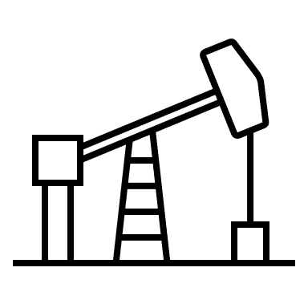

5. Discussion
34
Considering current conditions in China and India and the findings of this study, both governments should implement policies that not only support the development of stable steel scrap supply chains but also promote the adoption of natural gas–based DRI instead of coal-based DRI.
Notes:
Considering current conditions in China and India and the findings of this study, both governments should implement policies that not only support the development of stable steel scrap supply chains but also promote the adoption of natural gas–based DRI instead of coal-based DRI.

Slide 39
6. Conclusion
35
In this study, we disaggregated the basic iron sector in the GLORIA MRIO into four separate sectors: pig iron, converter, EAF, and steel products.
Our findings highlight that, without such disaggregation, it is difficult to determine which specific steelmaking process the basic iron sector actually reflects or is primarily influenced by.
We also compared the embodied CO₂ emission intensities of the original basic iron sector with those of each disaggregated steelmaking process.
The results indicate that aggregating all steelmaking processes into a single sector can lead to significant aggregation bias, particularly when analyzing embodied CO₂ emission intensities.
Notes:
Finally, I talk about conclusion.
In this study, we disaggregated the basic iron sector in the GLORIA MRIO into four separate sectors: pig iron, converter, EAF, and steel products.
Our findings highlight that, without such disaggregation, it is difficult to determine which specific steelmaking process the basic iron sector actually reflects or is primarily influenced by.
We also compared the embodied CO₂ emission intensities of the original basic iron sector with those of each disaggregated steelmaking process.
The results indicate that aggregating all steelmaking processes into a single sector can lead to significant aggregation bias, particularly when analyzing embodied CO₂ emission intensities.

Slide 40
4. Results: Intermediate input in China’s pig iron sector
36
Top 5 share of each sector in the intermediate input of pig iron sector in China
Rank | Country | Sector Code | The share of each sector in the intermediate input of pig iron (#77-1) (%)
1 | CHN | #28 | 28 %
2 | AUS | #28 | 20 %
3 | CHN | #62 | 18 %
4 | CHN | #24 | 4 %
5 | CHN | #93 | 4 %
The domestic iron ore sector (#28) has the highest share at 28%.
This is followed by Australia’s iron ore sector (#28) with a share of 20%.
The domestic coke oven products sector (#62) accounts for 18%.
Notes:
In this presentation, due to time limitations, I focus on China’s pig iron and converter sectors, as well as India’s EAF and steel products sectors.
This table represents the top 5 share of each sector in the intermediate input of pig iron sectors in China.
It represents, from left to right, Rank, Supply country, Sector code, the share of each sector in the intermediate input of pig iron.
This table represents the following three points.
The domestic iron ore sector (#28) has the highest share at 28%.
This is followed by Australia’s iron ore sector (#28) with a share of 20%.
The domestic coke oven products sector (#62) accounts for 18%.

Slide 41
4. Results: Intermediate input in China’s converter sector
17
Top 5 share of each sector in the intermediate input of converter sector in China
Rank | Country | Sector Code | The share of each sector in the intermediate input of converter (#77-2) (%)
1 | CHN | #77-1 | 48 %
2 | CHN | #112 | 6 %
3 | CHN | #100 | 5 %
4 | CHN | #24 | 5 %
5 | CHN | #97 | 4 %
The domestic pig iron sector accounting for the largest share at 48%.
Since the converter process aims to remove impurities from pig iron, domestic pig iron (#77-1) makes up most intermediate inputs in the converter sector.
Notes:
This table represents the top 5 share of each sector in the intermediate input of basic iron and pig iron sectors in China.
This table represents the domestic pig iron sector accounting for the largest share at 48%.
Since the converter process aims to remove impurities (イムピュアリティーズ) from pig iron, pig iron makes up most intermediate inputs in the converter sector.

Slide 42
4. Results: Intermediate input in China’s basic iron sector
Top 5 share of each sector in the intermediate input of basic iron sector in China
Rank | Country | Sector Code | The share of each sector in the intermediate input of basic iron (#77) (%)
1 | CHN | #77 | 26 %
2 | CHN | #28 | 12 %
3 | CHN | #62 | 10 %
4 | AUS | #28 | 8 %
5 | CHN | #93 | 6 %
The domestic basic iron sector (#77) accounts for the largest share at 26 %.
This is followed by the domestic iron ore sector (#28) with 12 %.
The coke oven products sector (#62) accounts for 10 %.
Notes:
This table represents the top 5 share of each sector in the intermediate input of basic iron and pig iron sectors in China.
This table represents that the domestic basic iron sector (#77) accounts for the largest share at 26 %.
This is followed by the domestic iron ore sector (#28) with 12 %.
The coke oven products sector (#62) accounts for 10 %.

Slide 43
4. Results: Comparison before and after disaggregation
Top 5 share of each sector in the intermediate input of basic iron sector in China
Rank | Country | Sector Code | The share of each sector in the intermediate input of basic iron (#77) (%)
1 | CHN | #77 | 26 %
2 | CHN | #28 | 12 %
3 | CHN | #62 | 10 %
4 | AUS | #28 | 8 %
5 | CHN | #93 | 6 %
Comparing the basic iron sector with the disaggregated pig iron and converter sectors shows that it was unclear which steelmaking process the basic iron sector actually represented or was mainly influenced by.
Notes:
Comparing the basic iron sector with the disaggregated pig iron and converter sectors shows that it was unclear which steelmaking process the basic iron sector actually represented or was mainly influenced by.

Slide 44
4. Results: Intermediate input in India’s EAF sector
Top 5 share of each sector in the intermediate input of EAF sector in India
Rank | Country | Sector Code | The share of each sector in the intermediate input of EAF (#77-3) (%)
1 | IND | #37 | 16 %
2 | IND | #100 | 13 %
3 | IND | #102 | 8 %
4 | IND | #85 | 6 %
5 | IND | #63 | 5 %
The domestic iron ore sector (#28) has the highest share at 28%.
This is followed by Australia’s iron ore sector (#28) with a share of 20%.
The domestic coke oven products sector (#62) accounts for 18%.
Notes:
This table represents the top 5 share of each sector in the intermediate input of EAF sectors in India.
It represents, from left to right, Rank, Supply country, Sector code, the share of each sector in the intermediate input of pig iron.
This table represents the following three points.
The domestic iron ore sector (#28) has the highest share at 28%.
This is followed by Australia’s iron ore sector (#28) with a share of 20%.
The domestic coke oven products sector (#62) accounts for 18%.

Slide 45
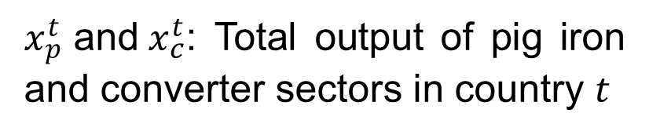
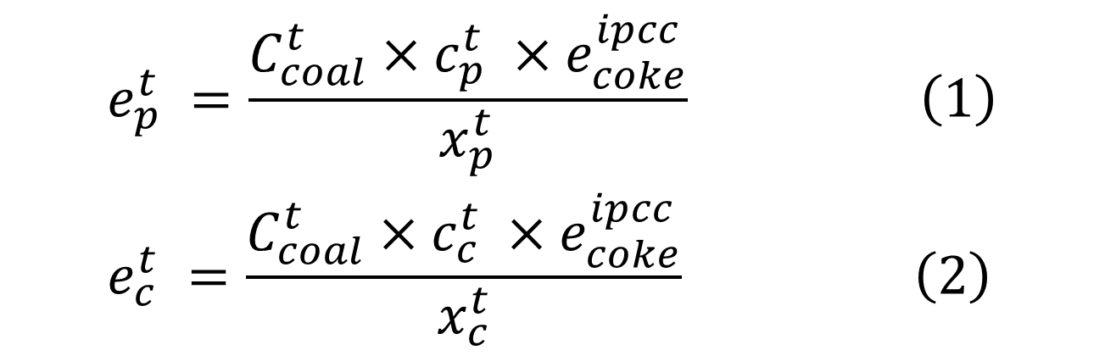
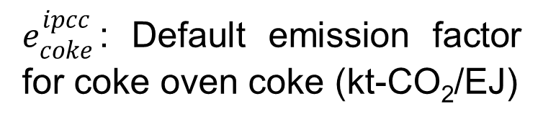
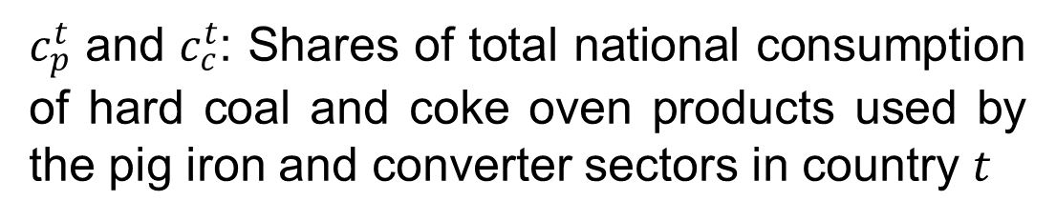
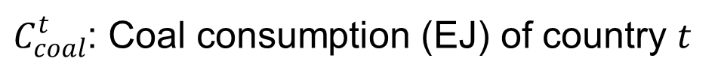
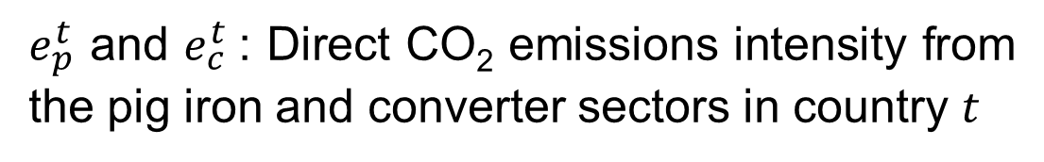
Appendix: Disaggregate direct CO₂ emission intensity
$$\begin{aligned}&e_{p}^{t} =\frac{C_{coal}^{t}×c_{p}^{t} ×e_{coke}^{ipcc}}{x_{p}^{t}} \left(1\right) \\ &e_{c}^{t} =\frac{C_{coal}^{t}×c_{c}^{t} ×e_{coke}^{ipcc}}{x_{c}^{t}} \left(2\right)\end{aligned}$$
$e_{p}^{t}$ and $e_{c}^{t}$: Direct CO₂ emissions intensity from the pig iron and converter sectors in country $t$
$e_{coke}^{ipcc}$: Default emission factor for coke oven coke (kt-CO₂/EJ)
$C_{coal}^{t}$: Coal consumption (EJ) of country $t$
$x_{p}^{t}\text{​ }\text{and} x_{c}^{t}$: Total output of pig iron and converter sectors in country $t$
$c_{p}^{t}\text{​ }\text{and} c_{c}^{t}$: Shares of total national consumption of hard coal and coke oven products used by the pig iron and converter sectors in country $t$
Notes:
This study calculated the direct CO₂ intensity vector of the pig ​iron, converter, EAF, and steel products sectors by equation 1, 2, 3, 4, respectively (リスペクティブリ)
We use these variables.
各変数を読む

Slide 46
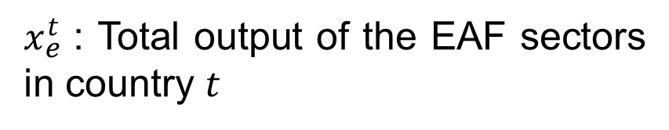
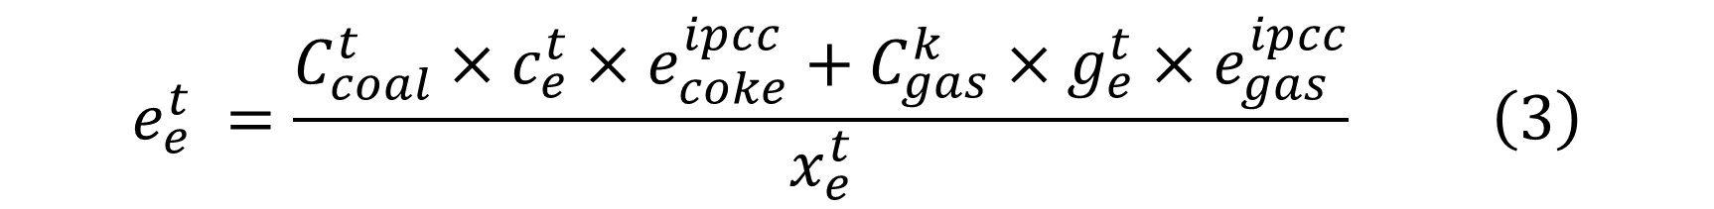
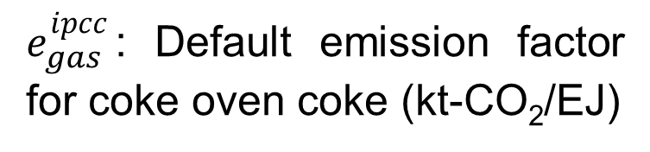
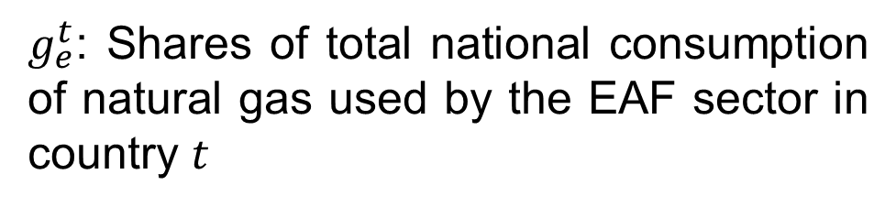
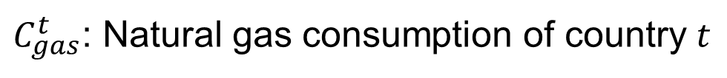
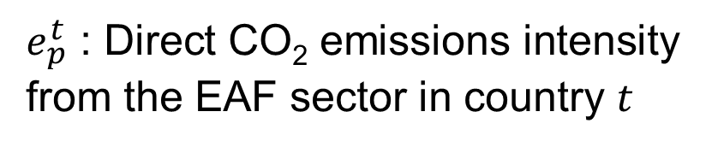
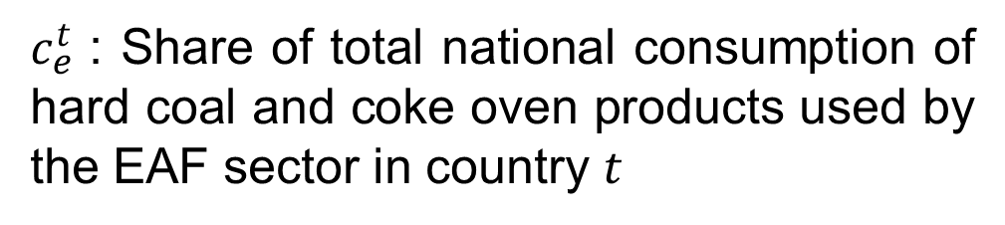
Appendix: Disaggregate direct CO₂ emission intensity
$$e_{e}^{t} =\frac{C_{coal}^{t}×c_{e}^{t}×e_{coke}^{ipcc}+C_{gas}^{k}×g_{e}^{t}×e_{gas}^{ipcc}}{x_{e}^{t}} \left(3\right)$$
$e_{p}^{t}$ : Direct CO₂ emissions intensity from the EAF sector in country $t$
$g_{e}^{t}$: Shares of total national consumption of natural gas used by the EAF sector in country $t$
$C_{gas}^{t}$: Natural gas consumption of country $t$
$e_{gas}^{ipcc}$: Default emission factor for coke oven coke (kt-CO₂/EJ)
$c_{e}^{t}\text{​ }$: Share of total national consumption of hard coal and coke oven products used by the EAF sector in country $t$
$x_{e}^{t}\text{​ }$: Total output of the EAF sectors in country $t$

Slide 47
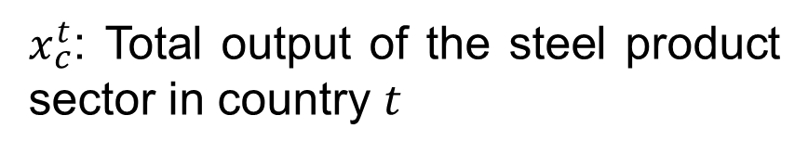
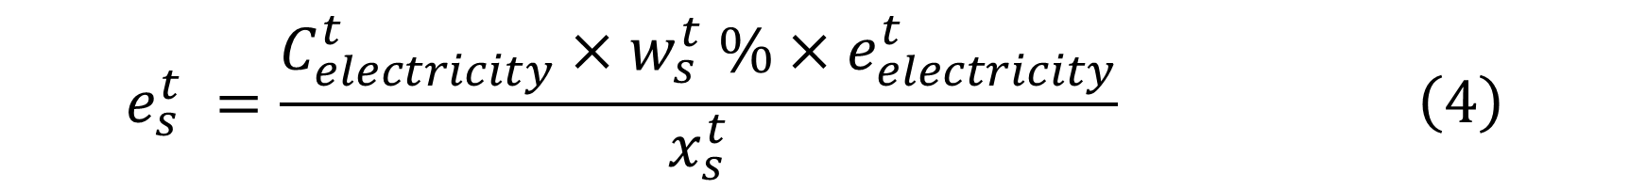
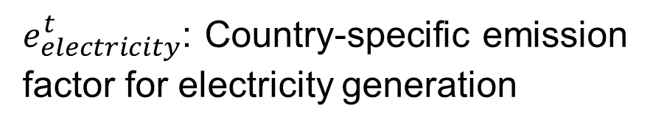
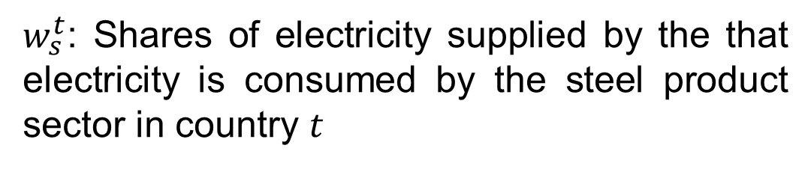
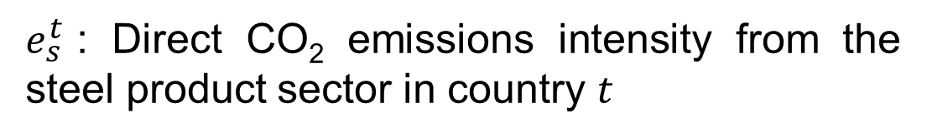
Appendix: Disaggregate direct CO₂ emission intensity
$$e_{s}^{t} =\frac{C_{electricity}^{t}×w_{s}^{t} \%×e_{electricity}^{t}}{x_{s}^{t}} \left(4\right)$$
$e_{s}^{t}$: Direct CO₂ emissions intensity from the steel product sector in country $t$
$e_{electricity}^{t}$: Country-specific emission factor for electricity generation
$C_{electricity}^{t}$: Electricity consumption of country $t$
$x_{c}^{t}$: Total output of the steel product sector in country $t$
$w_{s}^{t}$: Shares of electricity supplied by the that electricity is consumed by the steel product sector in country $t$

Slide 48
Results: Intermediate Input Differences in China’s Steel Sector
Top 5 share of each sector in the intermediate input of basic iron sector in China
Rank | Country | Sector Code | The share of each sector in the intermediate input of basic iron (#77) (%)
1 | CHN | #77 | 26 %
2 | CHN | #28 | 12 %
3 | CHN | #62 | 10 %
4 | AUS | #28 | 8 %
5 | CHN | #93 | 6 %
The domestic basic iron sector (#77) accounts for the largest share, at 26%, followed by the domestic iron ore sector (#28) and the coke oven products sector (#62), at 12% and 10%, respectively.
Notes:
This table represents the top 5 share of each sector in the intermediate input of basic iron and pig iron sectors in China.
It represents, from left to right, Rank, Supply country, Sector code, the share of each sector in the intermediate input of basic iron
This table represents the domestic basic iron sector accounts for the largest share at 26%, followed by the domestic iron ore sector (#28) and the coke oven products sector (#62), at 12% and 10%, respectively.

Slide 49
Basic iron
Crude steel
BF-BOF
Pig iron
Converter
EAF
Steel products
Notes:
First, this study disaggregates the domestic intermediate input from the Basic Iron sector into crude steel and steel products in six countries—China, India, Japan, South Korea, Russia, and the United States—within the GLORIA MRIO framework.

Slide 50
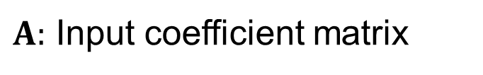
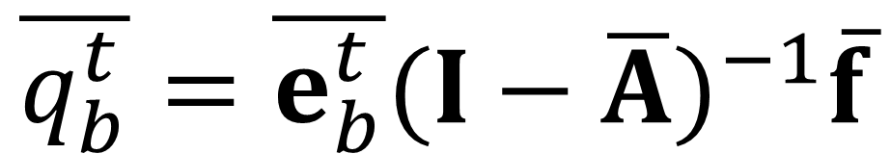
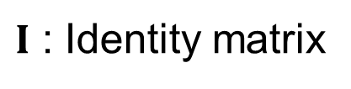
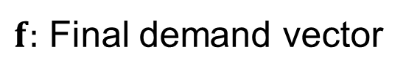
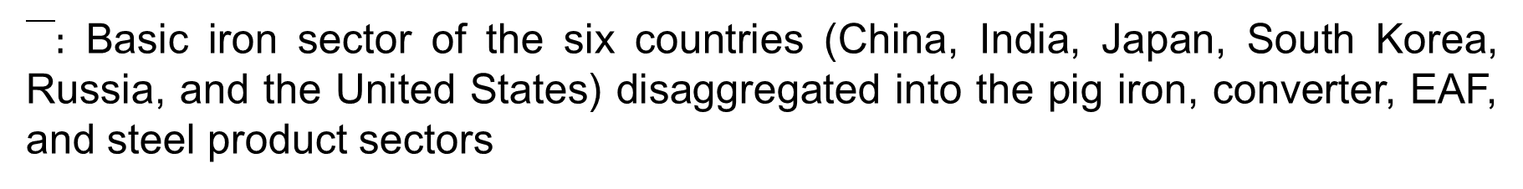
2.Methodology: Environmentally-Extended Input-Output Analysis
$$\overline{q_{b}^{t}}=\overline{e_{b}^{t}}{(I−\overline{A})}^{−1}\overline{f}$$
$\overline{}:$ Basic iron sector of the six countries (China, India, Japan, South Korea, Russia, and the United States) disaggregated into the pig iron, converter, EAF, and steel product sectors
$\overline{q_{b}^{t}}$: Direct and indirect CO₂ emissions from each steel making process in country $t$
$\overline{e_{b}^{t}}$: Direct CO₂ emission intensity vector, where only the pig iron, converter, EAF, and steel product sectors in country $t$ has non-zero values
$I$ : Identity matrix
$f:$ Final demand vector
$A:$ Input coefficient matrix
Notes:
本研究では、世界全体の最終需要に伴い発生する鉄鋼部門由来のカーボンフットプリントを推計するために、Environmentally-extended input-output analysisを用いた。
The bar symbol indicates that basic iron sector of the six countries (China, India, Japan, South Korea, Russia, and the United States) disaggregated into the pig iron, converter, EAF, and steel product sectors.
$\overline{q_{b}^{t}}$ indicates direct and indirect CO₂ emissions from each steel making process (in other words, pig iron, converter, EAF, steel products) in country $t$
以下同様に各変数を読む。

Slide 51
We need the ratio of crude steel and finished steel products within the total input value from the basic iron sector.
Basic iron
Basic iron
$$⋮$$
$$⋮$$
50
50
 | Basic Iron
Pig iron
Ferroalloy
Crude steel (converter)
Crude steel (electric arc furnace)
Hot-rolled steel
Steel pipes and tubes
Cold-finished steel
Coated steel
Cast and forged steel
Cast iron pipes
Cast and forged iron products
Steel shearing and slitting industry
Other steel products
Iron ore
67 %
Basic iron
100
Crude steel
？
80
？
33 %
Coke
Steel products
$$⋮$$
80
$$⋮$$
Estimate the intermediate input ratios of crude steel and finished steel products.
Notes:
The left figure represents the intermediate input vector of China’s basic iron sector.
First, we disaggregate the inputs from China's Basic Iron sector into crude steel and finished steel products.
To do this, we need the ratio of crude steel and finished steel products within the total input value from the Basic Iron sector.
As detailed technical data for the steel sector, we utilized Japan’s input–output table, in which the iron and steel sector is subdivided into pig iron, converter, EAF, and steel products to support this disaggregation.
This table represents intermediate inputs ratio of Japan’s iron and steel sector, and we estimate the intermediate input ratios of crude steel and finished steel products.
As a result, 67% of the inputs from the Basic Iron sector are attributed to crude steel, and 33% to finished steel products.

Slide 52
Extracting crude and finished steel sectors from intermediate inputs of Japan’s iron and steel sector.
Basic iron
Basic iron
$$⋮$$
$$⋮$$
50
50
 | Basic Iron
Pig iron
Ferroalloy
Crude steel (converter)
Crude steel (electric arc furnace)
Hot-rolled steel
Steel pipes and tubes
Cold-finished steel
Coated steel
Cast and forged steel
Cast iron pipes
Cast and forged iron products
Steel shearing and slitting industry
Other steel products
Iron ore
67 %
Basic iron
100
Crude steel
67
80
33
33 %
Coke
Steel products
$$⋮$$
80
$$⋮$$
Estimate the intermediate input ratios of crude steel and finished steel products.
Notes:
By applying the estimated ratios to the inputs from China’s Basic Iron sector, we disaggregate them into crude steel and finished steel products.

Slide 53
Basic iron
Crude steel
BF-BOF
Pig iron
Converter
EAF
Steel products
Notes:
Next, this study disaggregates the domestic intermediate input from crude steel to BF-BOF and EAF.

Slide 54




Basic iron
Basic iron
$$⋮$$
$$⋮$$
50
50
By applying the country-specific BF–EAF production ratios published by the World Steel Association (e.g., 90 % BF and 10 % EAF for China), we disaggregate China’s crude steel into BF-BOF and EAF sectors.
60
Crude steel
67
BF-BOF
7
33
EAF
Steel products
33
80
80
$$⋮$$
$$⋮$$
Notes:
By applying the country-specific BF–EAF production ratios published by the World Steel Association (90% BF and 10% EAF for China), we disaggregate China’s crude steel into BF and EAF sectors.

Slide 55
Basic iron
Crude steel
BF-BOF
Pig iron
Converter
EAF
Steel products
Notes:
Next, this study disaggregates the domestic intermediate input from BF-BOF to Pig iron and converter.

Slide 56



Basic iron
Basic iron
This study estimate the ratio between the pig iron sector and the converter sector (including the ferroalloy sector) based on Japan’s IO table.
$$⋮$$
$$⋮$$
50
50
24
60
Pig iron
 | Basic Iron
Pig iron
Ferroalloy
Crude steel (converter)
BF-BOF
36
40 %
Converter
7
EAF
60 %
7
33
33
By applying this ratio to the disaggregated BF-BOF sector, we further disaggregate China’s BF-BOF sector into a pig iron sector and a converter sector.
80
80
$$⋮$$
Notes:
To disaggregate, this study estimate the ratio between the pig iron sector and the converter sector (including the ferroalloy sector) based on Japan’s input-output table.
By applying this ratio to the disaggregated BF-BOF sector, we further disaggregate China’s BF-BOF sector into a pig iron sector and a converter sector.
Starting from the next slide, I will explain how the intermediate input structure of China’s Basic Iron sector is disaggregated into pig iron, converter, EAF, and finished steel products.

Slide 57
Basic iron
Crude steel
BF-BOF
Pig iron
Converter
EAF
Steel products
Notes:
this study disaggregates the intermediate input structure of the Basic Iron sector into crude steel and steel.

Slide 58







Crude steel
Steel products
This study disaggregate China’s basic iron sector into crude steel and finished steel products.
Basic iron
$$⋮$$
$$⋮$$
$$⋮$$
Iron ore
50
50
0
Ratios applied to each intermediate input
As detailed technical data for the steel sector, we used Japan’s IO table to estimate the input ratios.
24
20
4
Pig iron
Converter
36
0
36
7
1
6
 | Crude steel | Steel products
Iron ore | 100 % | 0 %
Pig iron | 80 % | 20 %
Coke | 56 % | 44 %
EAF
Steel products
33
0
33
$$⋮$$
$$⋮$$
$$⋮$$
Coke
80
45
35
$$⋮$$
$$⋮$$
$$⋮$$
Notes:
This study disaggregate China’s Basic Iron sector into crude steel and finished steel products.
To do this, we apply the ratio of crude steel to finished steel products in intermediate inputs.
As detailed technical data for the steel sector, we used Japan’s IO table to estimate the input ratios.
This table shows the input ratios of each intermediate good used by Japan’s crude steel and finished steel product sectors.
For example, all of the iron ore input is allocated to the crude steel sector, with no input going to finished steel products.
In contrast, about 80% of pig iron is used in the crude steel sector, while the remaining 20% is used in finished steel products.
Based on these estimated ratios for each intermediate good, we apply them to the intermediate inputs of China’s Basic Iron sector.

Slide 59
Basic iron
Crude steel
BF-BOF
Pig iron
Converter
EAF
Steel products
Notes:
Next, this study disaggregates the intermediate input structure of crude steel to BF-BOF and EAF.

Slide 60
Crude steel
BF-BOF
EAF
$$⋮$$
$$⋮$$
$$⋮$$
To understand the characteristics of the intermediate input structures of BF-BOF and EAF, it is necessary to know the share of each intermediate input used by each steelmaking route.
Iron ore
50
?
?
20
?
?
Pig iron
Converter
0
?
?
1
?
?
EAF
This study estimates the BF-BOF and EAF input shares for each intermediate good based on country-specific cost data (GSCT) provided by TransitionZero.
Steel products
0
?
?
Coke
45
?
?
$$⋮$$
$$⋮$$
$$⋮$$
Notes:
To understand the characteristics of the intermediate input structures of BF-BOF and EAF, it is necessary to know the share of each intermediate input used by each steelmaking route.
Therefore, this study estimates the BF-BOF and EAF input shares for each intermediate good based on country-specific cost data provided by TransitionZero.

Slide 61
Allocation of Intermediate Inputs by BF-BOF and EAF Shares (China, based on GSCT)
GLORIA | GSCT | Ratio | Route
EAF | DRI | 1.00 | EAF
 | Scrap | 1.00 | EAF
Pig iron | Pig iron | 0.96 | BF-BOF
 | Pig iron | 0.04 | EAF
Iron ore | Iorn ore | 1 | BF-BOF
Coke oven products | Coke | 1 | BF-BOF
Hard coal, Petroleum extraction, Gas extraction | Fuel | 0.67 | BF-BOF
 | Fuel | 0.33 | EAF
Electric power generation, transmission and distribution | Electricity | 0.85 | BF-BOF
 | Electricity | 0.15 | EAF
Cement, lime and plaster products, Basic inorganic chemicals, Manufacture of other non-metallic mineral products | other costs | 0.93 | BF-BOF
 | other costs | 0.07 | EAF
Match the sector classifications of GLORIA with the cost data categories listed in the GSCT
Focus on the share of each intermediate input used by BF-BOF and EAF, respectively
Notes:
Here, I explain the BF-BOF and EAF input ratios for each intermediate good, as estimated from the GSCT.
First, this study match the sector classifications of GLORIA with the cost data categories listed in the GSCT.
For example, DRI and scrap listed in the GSCT correspond to the “EAF” sector in GLORIA, while pig iron corresponds to the “Pig iron” sector.
Next, this study focus on the share of each intermediate input used by BF-BOF and EAF, respectively.

Slide 62
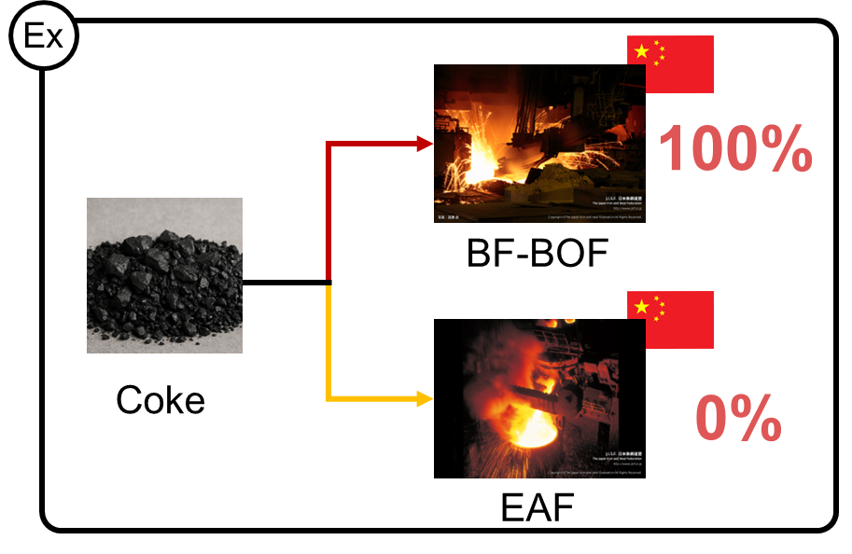
Allocation of Intermediate Inputs by BF-BOF and EAF Shares (China, based on GSCT)
GLORIA | GSCT | Ratio | Route
EAF | DRI | 1.00 | EAF
 | Scrap | 1.00 | EAF
Pig iron | Pig iron | 0.96 | BF-BOF
 | Pig iron | 0.04 | EAF
Iron ore | Iorn ore | 1 | BF-BOF
Coke oven products | Coke | 1 | BF-BOF
Ex
96%
BF-BOF
Pig iron
4%
EAF
Notes:
For example, pig iron is used at a ratio of 96% in BF and 4% in EAF.
Therefore, for the intermediate inputs sourced from the pig iron sector by China’s crude steel sector, we assume that 96% is used by the BF sector and the remaining 4% by the EAF sector.
In contrast, coke is used exclusively in BF (100%).
Accordingly, we assume that all coke used by China’s crude steel sector is allocated to the BF sector.

Slide 63
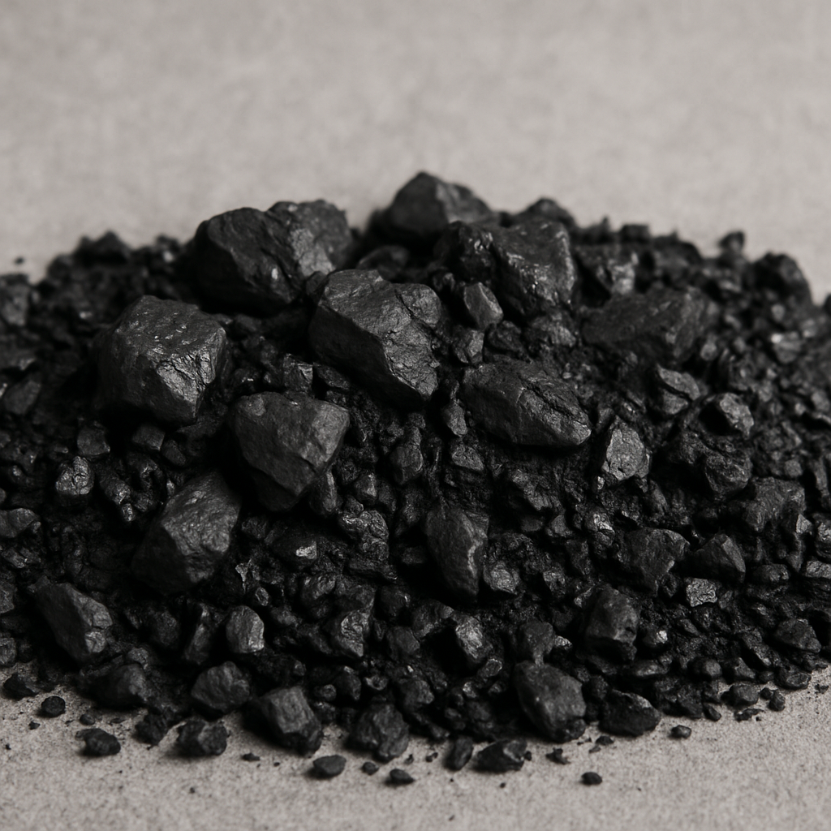
Methodology: Disaggregate to BF-BOF and EAF
Allocation of Intermediate Inputs by BF-BOF and EAF Shares (China, based on GSCT)
GLORIA | GSCT | Ratio | Route
EAF | DRI | 1.00 | EAF
 | Scrap | 1.00 | EAF
Pig iron | Pig iron | 0.96 | BF-BOF
 | Pig iron | 0.04 | EAF
Iron ore | Iorn ore | 1 | BF-BOF
Coke oven products | Coke | 1 | BF-BOF
Ex
Ex
96%
100%
BF-BOF
BF-BOF
Pig iron
4%
Coke
0%
EAF
EAF
Notes:
For example, pig iron is used at a ratio of 96% in BF and 4% in EAF.
Therefore, for the intermediate inputs sourced from the pig iron sector by China’s crude steel sector, we assume that 96% is used by the BF sector and the remaining 4% by the EAF sector.
In contrast, coke is used exclusively in BF (100%).
Accordingly, we assume that all coke used by China’s crude steel sector is allocated to the BF sector.

Slide 64



Crude steel
BF-BOF
EAF
$$⋮$$
$$⋮$$
$$⋮$$
Iron ore
50
50
0
20
18
2
Pig iron
Converter
0
0
0
1
0
1
EAF
Steel products
0
0
0
Coke
45
45
0
$$⋮$$
$$⋮$$
$$⋮$$
Notes:
We disaggregate the crude steel sector into BF and EAF sectors by applying the BF–EAF ratios for each intermediate input.

Slide 65
Basic iron
Crude steel
BF-BOF
Pig iron
Converter
EAF
Steel products
Notes:
Next, this study disaggregates the intermediate input structure of BF-BOF to Pig iron and converter.

Slide 66






BF-BOF
Pig iron
Converter
This study estimate the input ratios of the pig iron and converter sectors including ferroalloys for each intermediate good using Japan’s input-output table.
$$⋮$$
$$⋮$$
$$⋮$$
Iron ore
50
50
0
18
2
16
Pig iron
Converter
0
0
0
Ex
 | Pig iron | Converter
Iron ore | 100 % | 0 %
Pig iron | 10 % | 90 %
Coke | 70 % | 30 %
0
0
0
EAF
Steel products
0
0
0
$$⋮$$
$$⋮$$
$$⋮$$
Coke
45
45
0
$$⋮$$
$$⋮$$
$$⋮$$
Notes:
In this study, we estimate the input ratios of the pig iron and converter sectors—including ferroalloys—for each intermediate good using Japan’s input-output table.
The table below shows the estimated input ratios of pig iron and converter sectors for each intermediate good, based on Japan’s input-output table.
We then apply these ratios to each intermediate input of China’s BF-BOF sector.
As a result, we disaggregate China’s iron and steel sector into a pig iron sector and a converter sector.

Slide 67
4. Results: Intermediate input in India’s EAF sector
Top 3 share of each sector in the intermediate input of EAF sector in India
17 %
Quarrying of stone, sand and clay (#37)
India’s
EAF
Wholesale and retail trade (#100)
14 %
Hard coal (#24)
9 %
Others
The quarrying of stone, sand and clay (#37) has the highest share at 17%.
This is followed by wholesale and retail trade (#100) with a share of 14 %.
The hard coal sector (#24) accounts for 9 %.
Notes:
This graph represents the top 3 share of each sector in the intermediate input of EAF sectors in India.
We clarified three points.
The domestic iron ore sector (#28) has the highest share at 28%.
This is followed by Australia’s iron ore sector (#28) with a share of 20%.
The domestic coke oven products sector (#62) accounts for 18%.

Slide 68
4. Results: Intermediate input in India’s EAF sector
Top 3 share of each sector in the intermediate input of steel products sector in India
17 %
EAF (#77-3)
India’s
steel products
Steel products (#77-4)
17 %
Quarrying of stone, sand and clay (#37)
10 %
Others
The EAF sector (#77-3) has the highest share at 17%.
The steel products sector (#77-4) also has the highest share at 17 %.
The quarrying of stone, sand and clay (#37) accounts for 10 %.
Notes:
This graph represents the top 3 share of each sector in the intermediate input of steel products sectors in India.
We clarified three points.
The EAF sector (#77-3) has the highest share at 17%.
The steel products sector (#77-4) also has the highest share at 17 %.
The quarrying of stone, sand and clay (#37) accounts for 10 %.

Slide 69
21 %
21 %
9 %

Slide 70
Notes:
wholesale and retail trade (#100)
iron ore sector (#28)
hard coal sector (#24)
Professional, scientific and technical services(#114)
Q.なぜアメリカはbasic ironが多い？
→I have not looked into the details, but it is possible that U.S.A imports steel scrap and pig iron from other countries.

