Slide 1
Analyzing Critical Minerals Value Chains using the GTAP MRIO Data Base
Maksym Chepeliev
Center for Global Trade Analysis, Purdue University
30th International Input-Output Association Conference
July 1-5, 2024
Santiago, Chile

Slide 2
Outline
Motivation
GTAP Data Base v11
GTAP circular economy database
3. Incorporating critical minerals and downstream sectors
4. Sample application: demand for minerals under mitigation scenarios
5. Conclusions and next steps

Slide 3
Need for decoupling material use from economic growth
Current material use patterns are projected to put tremendous pressure on the Earth’s ecosystem
Changes in incomes and population together with a global convergence in material use patterns could result in over 2.5 times increase in global material demand by 2050 (Steffen et al., 2015).
These trends would represent a major challenge for the climate mitigation and other conservation efforts.
The need to move toward a more sustainable material consumption patterns is widely recognized and is promoted within a Circular Economy (CE) concept.
Modelling of the Circular Economy transition requires an explicit representation of the primary and secondary production activities
Represent country-specific production volumes of primary and secondary activities.
Distinguish between corresponding supply and cost structures, e.g. for steel, aluminum, copper, other metals, plastics.
Such representation is not available in the standard GTAP Data Base.

Slide 4
Previous efforts at modeling circularity have a number of limitations
A number of studies have represented the Circular Economy splits within the global CGE or IO modeling framework
MRIO assessments based on the EXIOBASE (e.g. Tisserant et al., 2017; Wiebe et al., 2019).
CGE-based assessment focusing on selected sector/commodity (e.g. Winning et al., 2017 for the case of steel).
GTAP-based assessments with a more detailed splits, e.g. OECD (2019), Dellink (2020), Bibas et al. (2021).
Selected limitations of the existing approaches:
Are based on the EXIOBASE cost structures and output values, which do not always correspond to the actual observations (see e.g. Winning et al., 2017).
Focus on selected commodities or specific aggregate regional representations.
Are not consistently updated over time.
Not publicly available.

Slide 5
Representation of the future energy transition requires new sectoral details (both upstream and downstream)
Achieving climate mitigation targets will require an unprecedented expansion in renewable infrastructure and technologies
Such transition will lead to the growing demand for critical minerals, such as nickel, platinum group metals, zinc, rare earths, etc., which are essential inputs for the development of renewable energy systems (Tokimatsu et al., 2018).
It is estimated that within the pathways toward limiting global warming below 1.5oC, the demand for critical minerals could increase between 2 and 267 times by 2050 depending on the mineral (Wang et al., 2022).
Apart from pure supply and logistical constraints, the rising demand for critical minerals is also associated with national security aspects and is prone to generate geopolitical frictions (Vakulchuk et al., 2022).
It is important to have the analytical capacity for the analysis of future energy transition scenarios with an explicit representation of the critical minerals value chains (both upstream and downstream).

Slide 6
GTAP Data Base v11

Slide 7
Key features of the GTAP 11
Five reference years
2004, 2007, 2011, 2014, 2017
141 countries + 19 aggregate regions
20 new and 39 updated national IOTs have been incorporated
Individual countries cover 99% of the world GDP and 96% of its population
Format consistent with the new standard GTAP model
GAMS containers, and distribution available for classic GTAP

Slide 8
Evolution of the GTAP Data Base

Slide 9
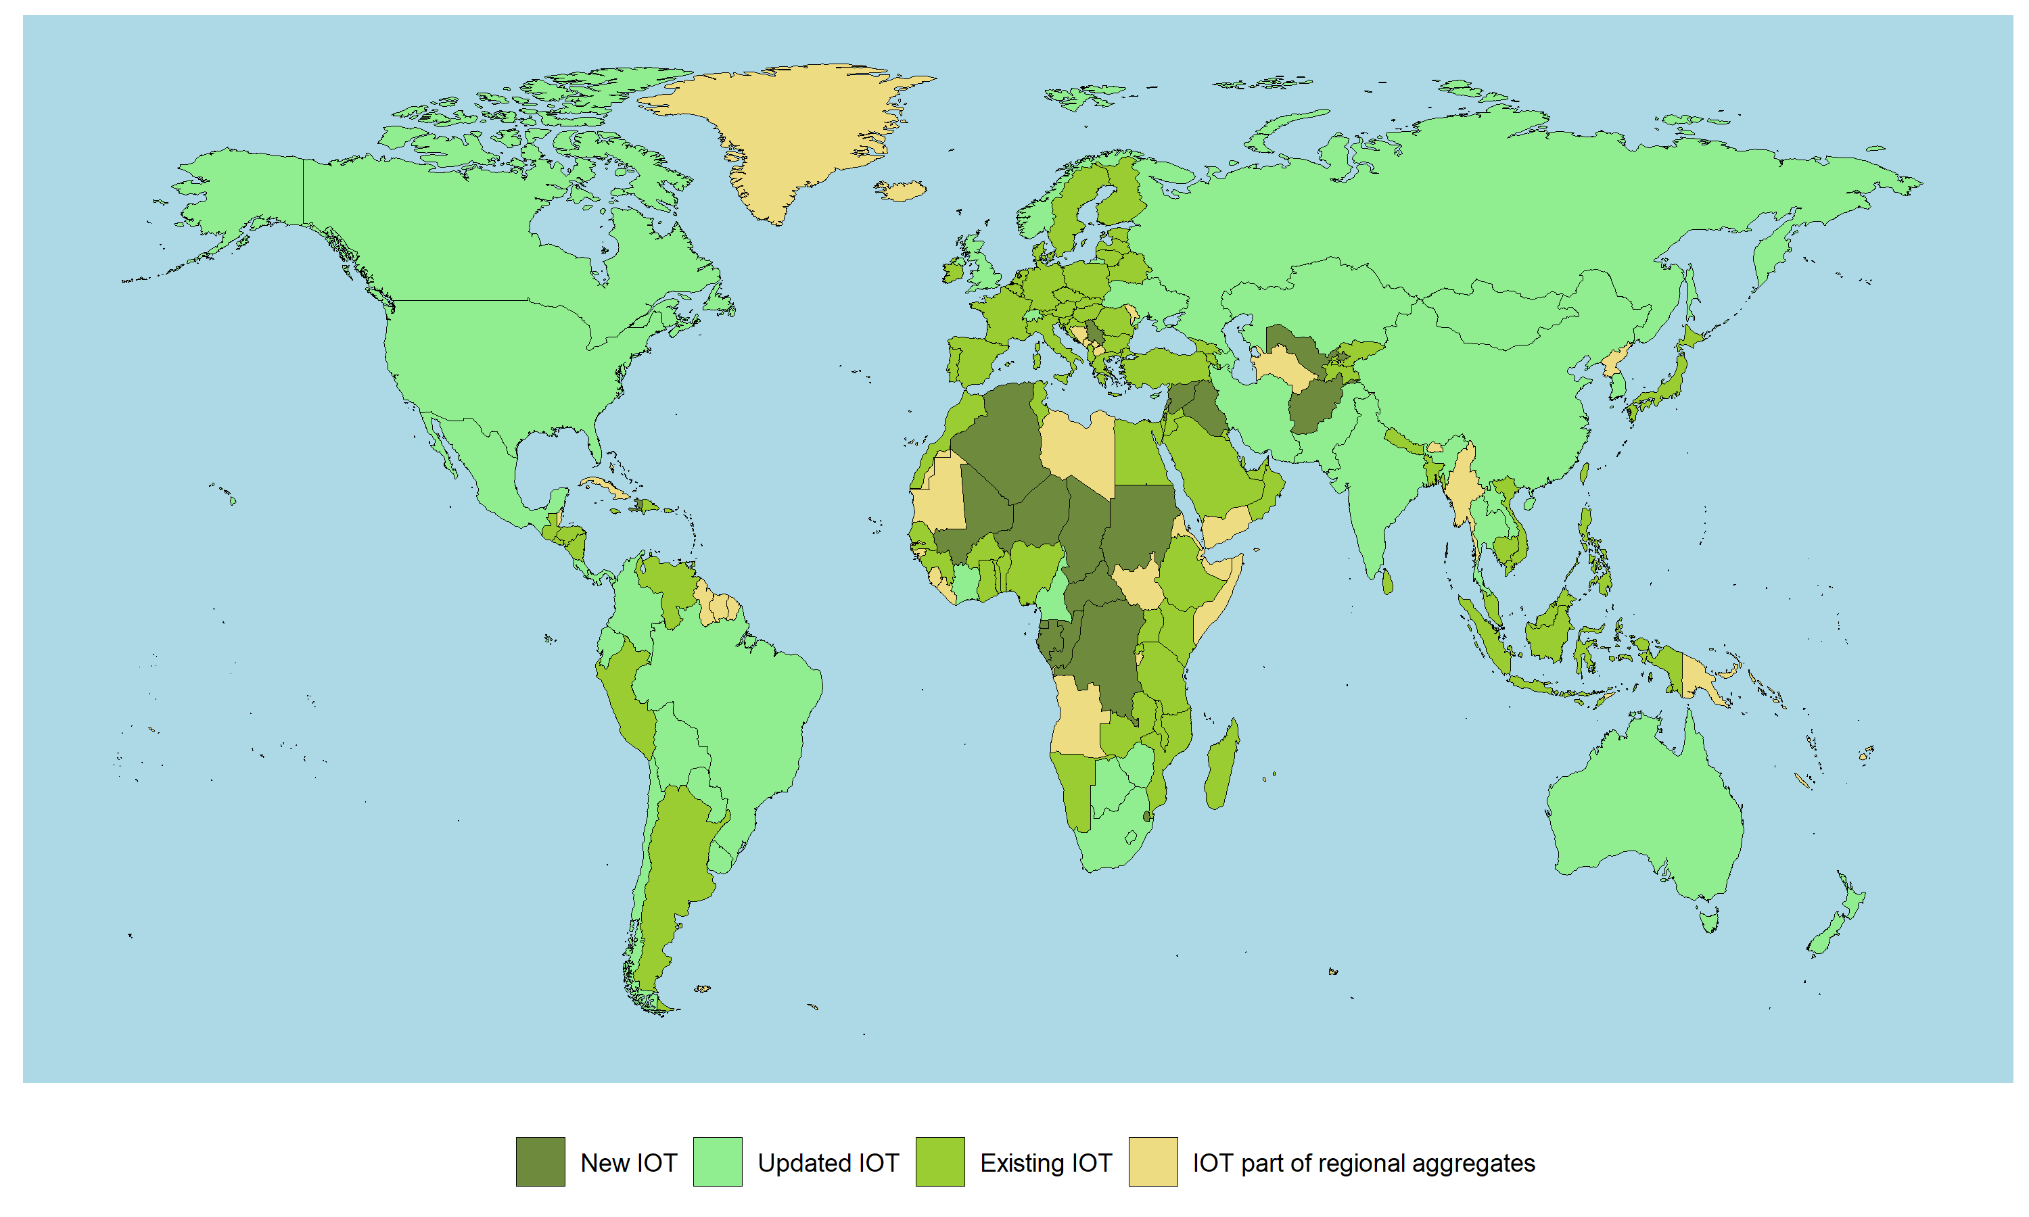
GTAP 11: A major expansion of coverage in Africa
Afghanistan
Algeria
Central African Republic
Chad
Comoros
The Congo Republic
The Democratic Republic of the Congo
Equatorial Guinea
Eswatini
Gabon
Haiti
Iraq
Lebanon
Mali
Niger
Palestine
Serbia
Sudan
Syria
Uzbekistan.

Slide 10
Commodity coverage in GTAP 11
Paddy rice | Coal | Wood products | Electrical eqpt. | Communication
Wheat | Oil | Pulp, paper etc. | Other mach. & eqpt. | Financial services
Other cereals | Gas | Refined oil etc. | Other manu. | Insurance
Vegetables & fruits | Other minerals | Pharmaceuticals | Electricity | Real estate
Oil seeds | Red meat | Other chemicals | Gas distribution | Other bus. services
Sugar cane & beet | White meat | Rubber & plastics | Water | Recreation etc.
Plant-based fibers | Vegetable oils | Other mineral prod. | Construction | Public Admin.
Other crops | Dairy products | Ferrous metals | W & R trade | Education
Beef etc. | Processed rice | Other metals | Hotels, rests. etc. | Health
Poultry, pork, etc. | Refined sugar | Metal products | Warehousing etc. | Dwellings
Raw milk | Other food | Mot. vehicles & parts | Land transport
Wool etc. | Beverages & tobacco | Other trp. eqpt. | Sea transport
Forestry | Textiles | Electronic eqpt. | Air transport
Fishing | Clothing
 | Leather products
Energy intensive
Agriculture etc.
Services
Processed food
Oth. Manufacturing

Slide 11
GTAP-CE Data Base v11

Slide 12
GTAP-CE v11 consolidates and extends previous efforts

Slide 13
GTAP-CE v11 introduces additional sectoral splits
No. | GTAP | New sector | Description
1 | oxt | nmn | Non-metallic minerals mining
2 |  | mio | Mining of iron ores
3 |  | mao | Mining of aluminum ores
4 |  | mco | Mining of copper ores
5 |  | moo | Mining of other ores
6 | rpp | rbr | Rubber products
7 |  | plp | Plastic products – primary
8 |  | pls | Plastic products – secondary
9 |  | plr | Recycling - plastics
10 | nmm | cem | Cement
11 |  | nmx | Other mineral products
12 | i_s | isp | Iron and steel – primary
13 |  | iss | Iron and steel – secondary
14 |  | ris | Recycling - iron and steel
15 |  | isc | Iron and steel casting
16 | nfm | app | Aluminum – primary
17 |  | aps | Aluminum – secondary
18 |  | ral | Recycling - aluminum
19 |  | cpp | Copper – primary
20 |  | cps | Copper – secondary
21 |  | rcp | Recycling - copper
22 |  | mpp | Other metals – primary
23 |  | mps | Other metals – secondary
24 |  | rom | Recycling - other metals
25 |  | nfc | Non-ferrous metals casting
26 | chm | nfr | Nitrogen fertilizer
27 |  | pfr | Phosphorus fertilizer
28 |  | kfr | Potassium fertilizer
29 |  | xch | Other chemicals
76 GTAP-Power 11 Data Base sectors are disaggregated into 99 sectors
These sectoral splits provide a complete coverage of the CBAM commodities (except hydrogen)

Slide 14
The database construction process utilizes a variety of data sources
(4) Database split
Data: Split targets from Step 3.
(5) Construction of the final database
Data: Disaggregated database from Step 4.
(1) Data preparation (output splits)
Data: Volumes of primary and secondary production, volumes of waste, recycling rates, bilateral trade data for sectors or interest.
Construction of the production targets using volume and price data.
GTAP Data Base split using SPLITCOM.
(3) Targets’ reconciliation
Reconciliation of the production targets, supply/use structures and trade data for disaggregated SAMs extracted from the GTAP.
Data: GTAP 11 Power Data Base, data inputs from Steps 1 and 2.
Incorporation of the energy and emission flows for disaggregated sectors. Compilation of the final database.
(2) Data preparation (supply/use splits)
Data: Disaggregated individual country input-output tables (USA, Korea, Japan, Canada), EXIOBASE, specific cost structure assumptions.
Data sources: USGS, UNIDO, BACI, UNEP IRP MFA, PRODCOM, World Steel, Jambeck et al. (2015), Plastics Europe, Veolia, multiple country-specific data sources (for plastic recycling rates), World Bank, International Fertilizer Association (IFA), FAO.
Construction of the cost structure targets.

Slide 15
GTAP-CE v11: Sectoral composition

Slide 16
Incorporating Critical Minerals into the GTAP Data Base

Slide 17
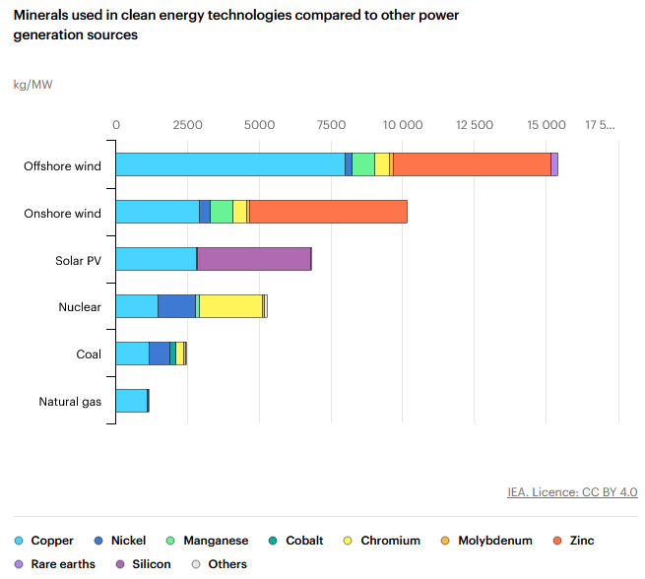
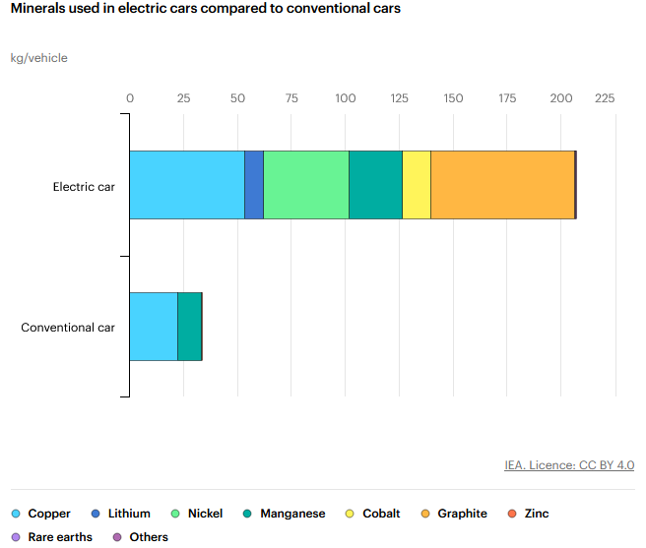
Energy transition will increase demand for selected minerals
Source: IEA (2024) https://www.iea.org/reports/the-role-of-critical-minerals-in-clean-energy-transitions/executive-summary

Slide 18
Renewable technologies will also demand metals
Source: Liang et al. (2022), Carrara et al. (2020), Watari et al. (2019), Deetman et al. (2021), Wang et al. (2022). Data collections have been kindly shared by colleagues from PNNL.

Slide 19
Additional sectoral splits are being incorporated to represent mining and refining of selected minerals
Data collections from USGS and other sources:
Covering selected ores and metals.
Ore mining, metal production and bilateral trade flows.
Price data across metals and ores.
Primary and secondary production split data.

Slide 20
Should primary and recycling activities be considered for (selected) metals?
Caveats:
Country-specific data on recycling rates is often missing.
Recycling rates might vary substantially across sectors.
Source: https://www.resourcepanel.org/reports/recycling-rates-metals

Slide 21
Downstream sectoral splits are also considered
Currently considered sectoral/commodity splits include:
Solar panels.
Wind turbines.
Electric vehicles split out of GTAP motor vehicles (‘mvh’) sector (potentially differentiated by type – commercial, residential).
Batteries (differentiated by type).

Slide 22
Exploratory application: Demand for minerals under climate mitigation scenarios

Slide 23
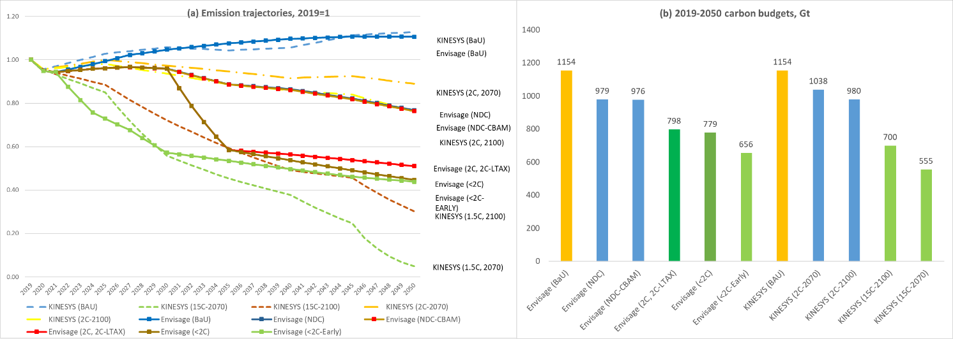
Methodology: Linking CGE and global energy system models
Source: Chepeliev, Giannakidis, Kanudia, and van der Mensbrugghe (2024). “Implications of the Net Zero Transition Scenarios on SDG Indicators: Linking Global Energy System, CGE and Atmospheric Source-receptor Models”, Springer Nature, Lecture Notes in Energy (forthcoming).

Slide 24
KYNESIS model is run till 2100 with imposed carbon budgets
Knowledge-based Investigation of Energy System Scenarios (KINESYS) is a multi-region inter-temporal PE model of the global energy system, which is developed using the TIMES model generator of IEA-ETSAP (Kanudia 2023).
KINESYS integrates assumptions across fuel, technology, and policy landscapes to explore how the entire energy system responds to different incentives and constraints.
For the electric power sector, demand is modeled through seasonal and daily time slices.
On the technological side, the model represents several negative emission technologies, including direct air capture, bioenergy with carbon capture and storage (BECCS) and hydrogen BECCS (H2 BECCS).
No. | Scenario | Budget period | Budget, Gt | Scenario description
1. | 2C-2070 | 2020-2070 | 1310 | 2ºC-consistent scenario with carbon budget imposed over the 2020-2070 period
2. | 2C-2100 | 2020-2100 | 1310 | 2ºC-consistent scenario with carbon budget imposed over the 2020-2100 period
3. | 1.5C-2070 | 2020-2070 | 460 | 1.5ºC-consistent scenario with carbon budget imposed over the 2020-2070 period
4. | 1.5C-2100 | 2020-2100 | 460 | 1.5ºC -consistent scenario with carbon budget imposed over the 2020-2100 period

Slide 25
Installed capacities of renewable generation technologies grow significantly over time

Slide 26
Low carbon transition substantially increases demand for selected minerals
Change in demand for selected metals due to new generation technologies and related infrastructure under the “1.5-C” 2070 scenario
x 6 times

Slide 27
Conclusions and next steps
GTAP circular economy database v11:
Preliminary version is available and currently under testing (is planned to be publicly shared later this year).
Next steps:
Refining the set upstream and downstream sectoral splits.
Data collection on the cost structures of the downstream sectors.
Incorporation of the critical minerals and downstream sectoral splits to the GTAP-CE v11 Data Base.
Implementation of the constructed database in the ongoing set of projects focusing on climate mitigation policies.

Slide 28
Thank you! Questions/Comments?
mchepeli@purdue.edu

